Slide 1

I AM AAKASH DHAKSHNAMOORTHY
-BUILDING AGENTIC AI WORKFLOWS WITH MICROSOFT AUTOGEN

Slide 2
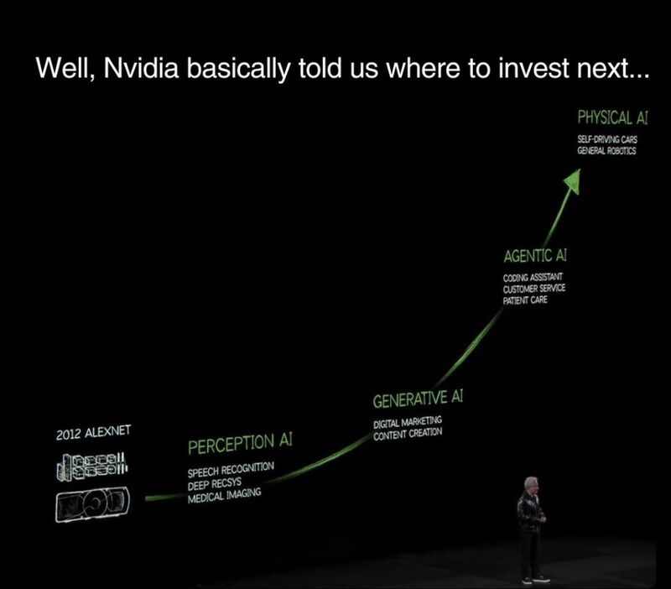

Slide 3
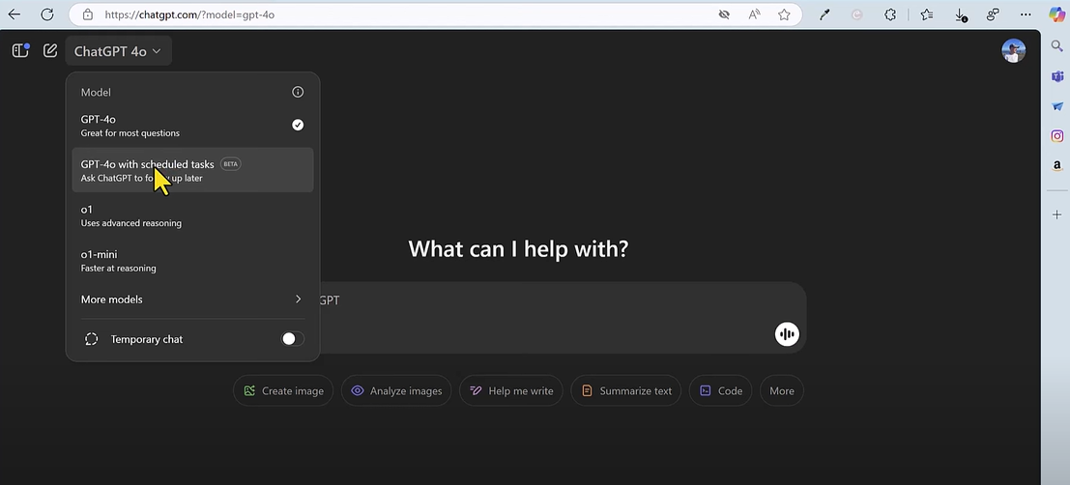

CHAT GPT TASKS

Slide 4
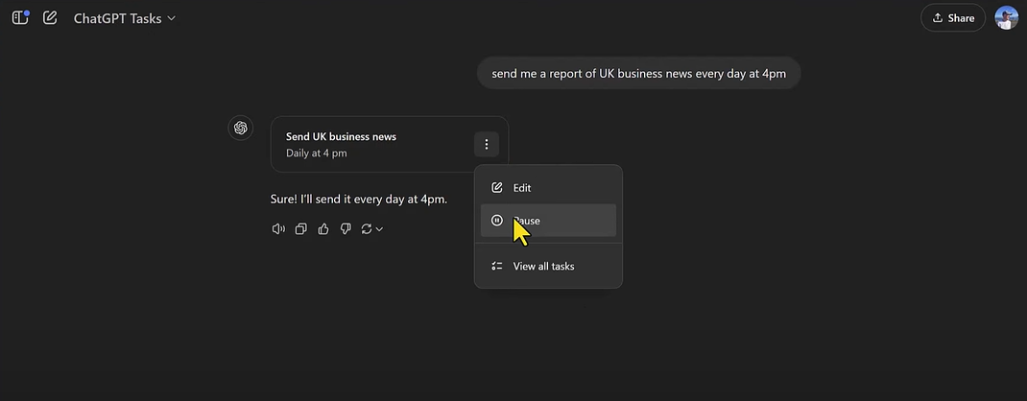
CHAT GPT TASKS

Slide 5

GEN AI WORK-FLOW
LLM
USER QUERY
OUTPUT
PROMPT

Slide 6
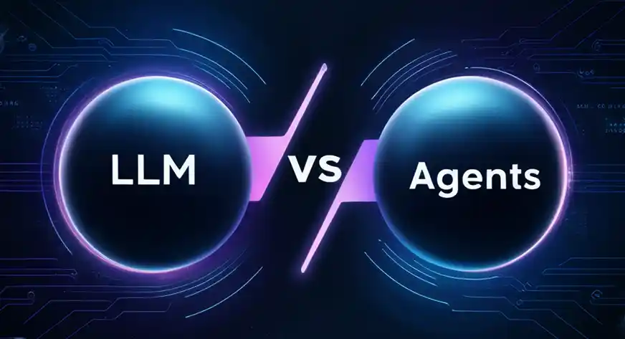
LLM vs AGENTS

Slide 7

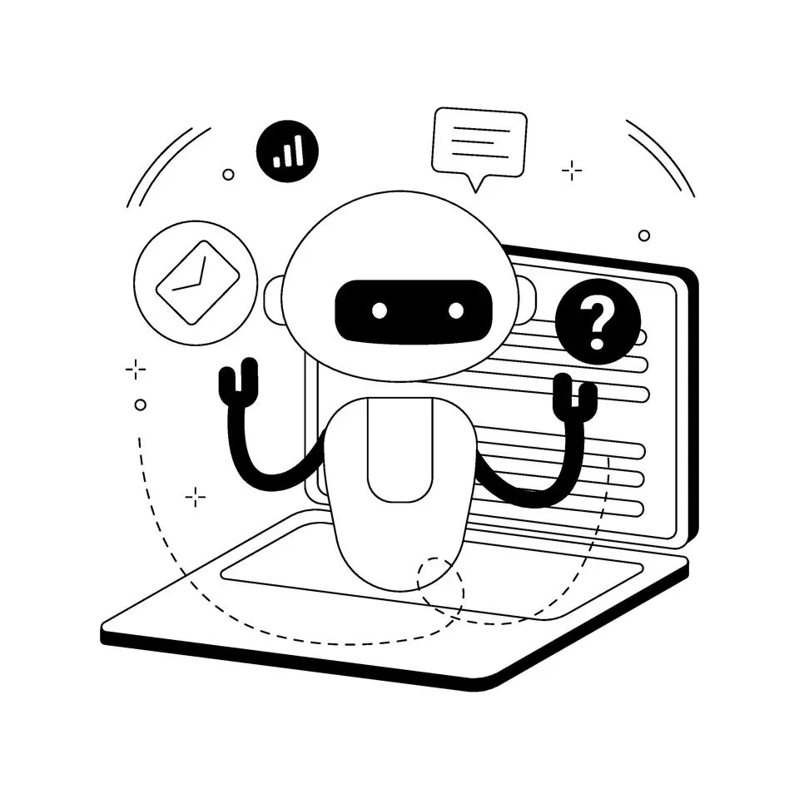

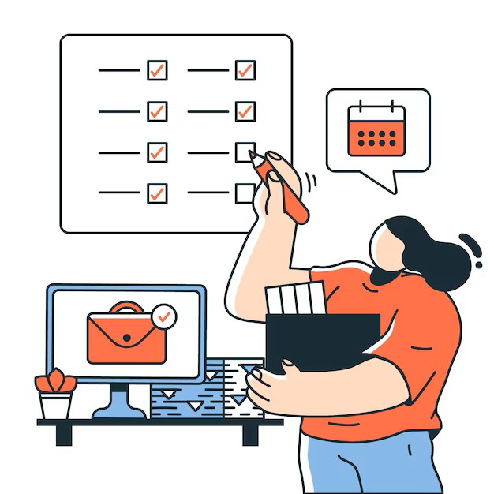

AGENTIC AI WORK-FLOW
TOOLS
AGENTS
USER
TASKS

Slide 8
MULTI-AGENTS WORK- FLOW
TOOLS
AGENT1
AGENT2
USER
TASK1
TASK2

Slide 9

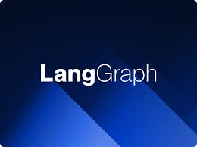


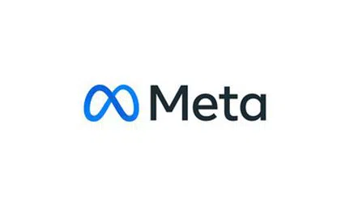
CODE-BASED FRAMEWORKS
CREW AI
LANG GRAPH
AUTO GEN
OPENAI SWARM
META GPT

Slide 10
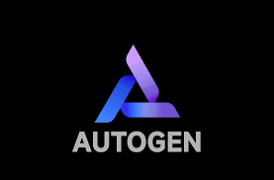


UI-BASED FRAMEWORKS
n8n
AUTO GEN
SUPER AGI

Slide 11
COMPONENT IN AUTO-GEN:
AGENTS
MODELS
TOOLS
TERMINATIONS

Slide 12
AUTO-GEN WORK-FLOW
AGENT1
USER QUERY
CHAT MANAGER
AGENT2
OUTPUT
AGENT3

Slide 13
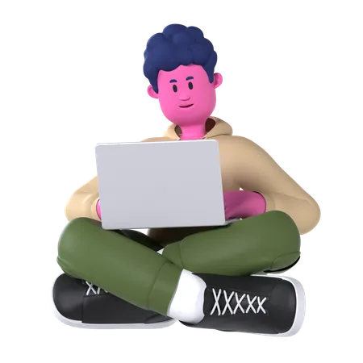
DEMO

Slide 14
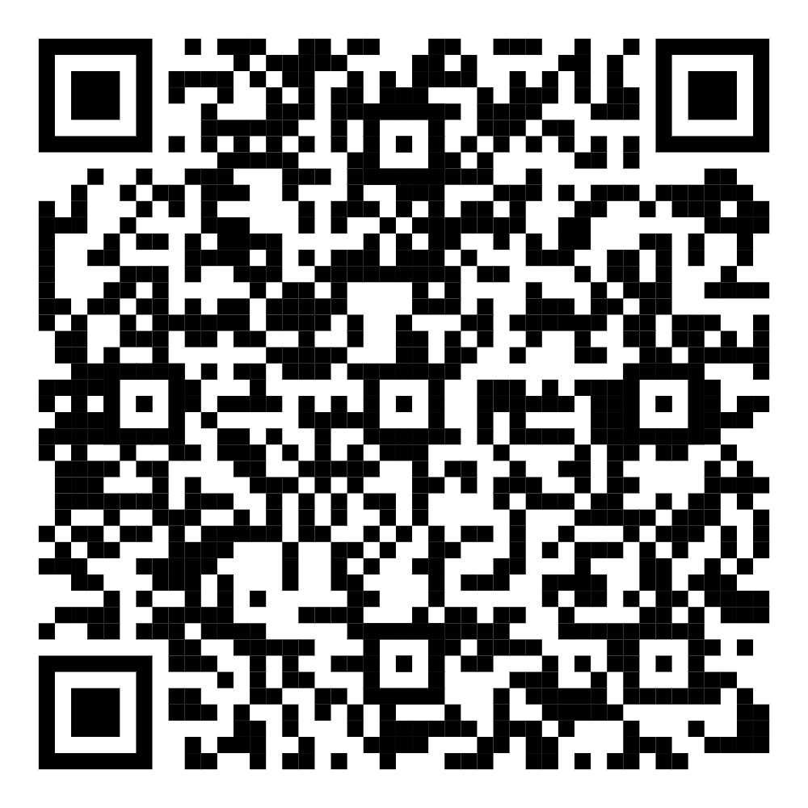
THANK YOU
CONNECT ME HERE

